Slide 1
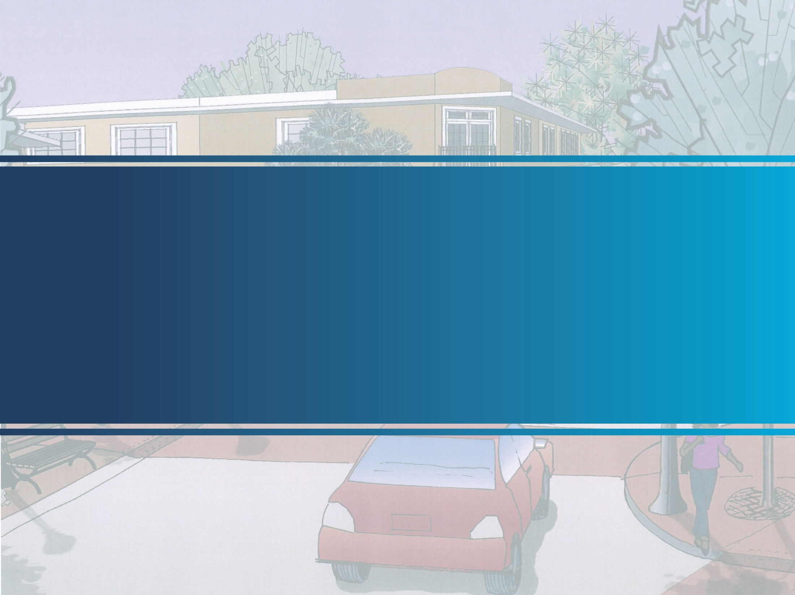
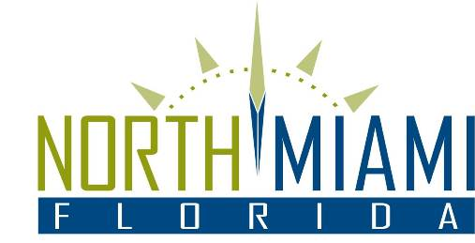

Downtown Master Plan
“From Genesis to Action”
Downtown Revitalization Forum
May 14, 2014

Slide 2
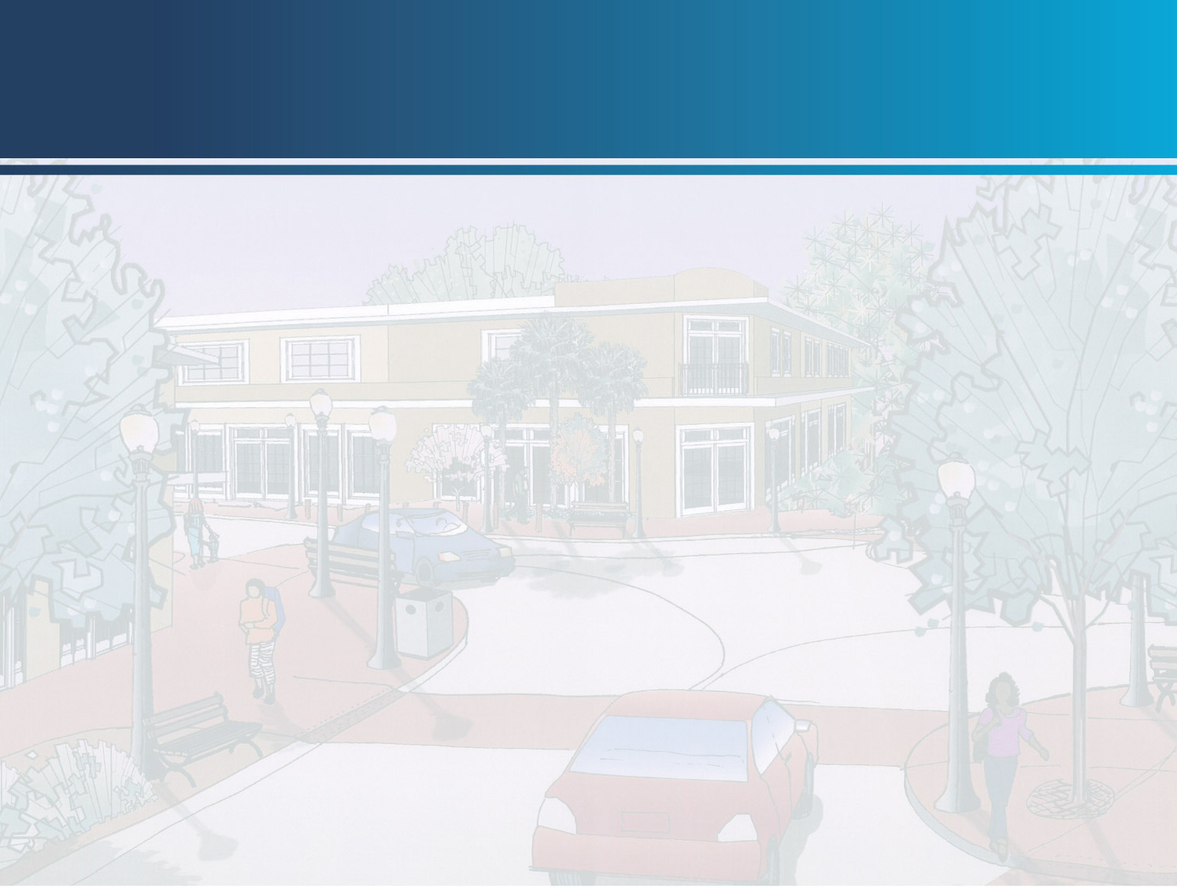
Downtown Development Plan
Genesis:
November 2012, City engaged K&S to:
Complete an assessment of the economic and redevelopment opportunities and constraints;
Tie together all of the studies and work previously undertaken by the City;
Complete an assessment of the economic and redevelopment opportunities and constraints;
Help determine an appropriate vision; and
Create a redevelopment plan, including guidelines to implement the vision for the study area.

Slide 3
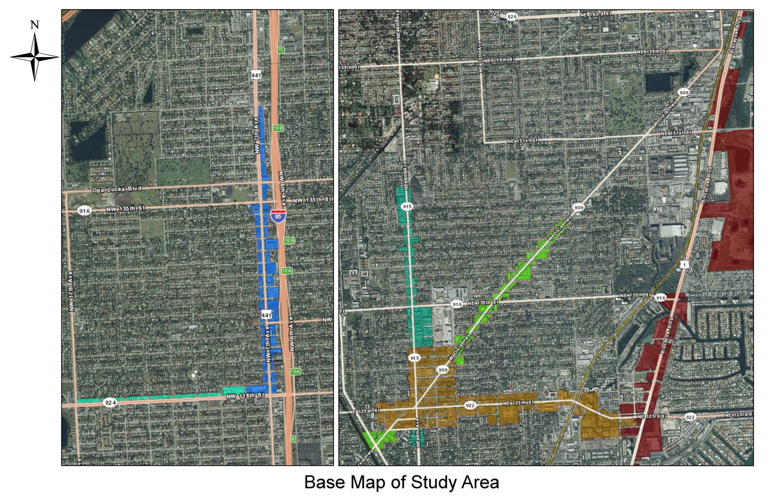
Downtown Development Plan
Process: Downtown and Major Corridor Boundaries
Red-Biscayne Boulevard
Teal-NE 6th Avenue
Green-W. Dixie Highway
Blue - NW 7th Ave/US441
Aqua-NW 119th Street
Gold-NE 125th Street

Slide 4
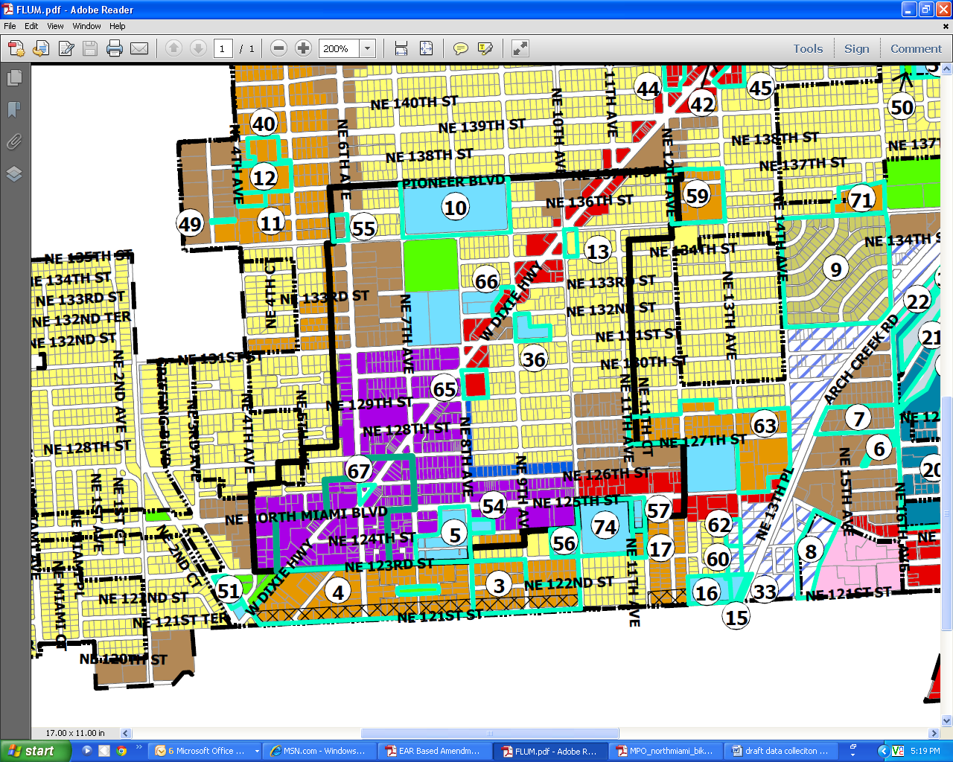
Downtown Development Plan
Process (cont’d): Downtown Boundary
NRO Boundary
(black line)
CCD Boundary (teal line)

Slide 5
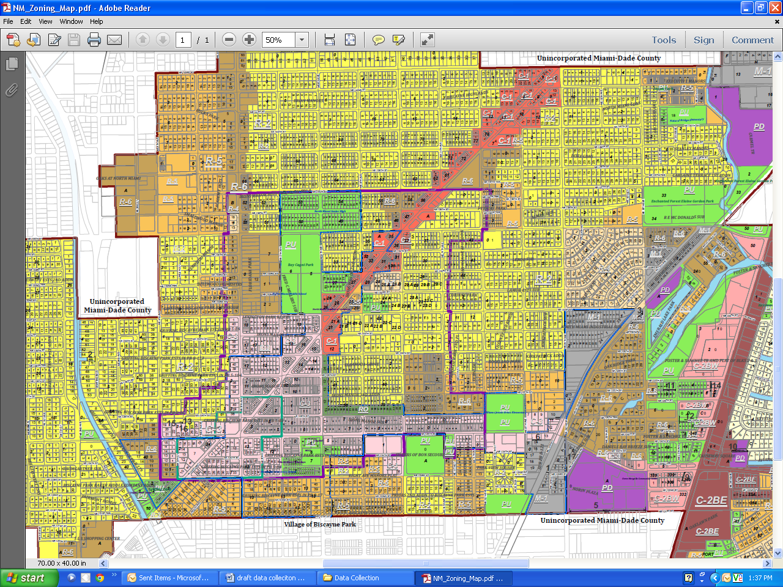
Downtown Development Plan
Process: (cont’d)
Self Assessment:
Review of All Existing Visioning/Economic Documents
Background and Existing Conditions
Demographics/Housing Analysis
Employment Characteristics and Commuting
Zoning and Land use Characteristics
Economic Development Foundations
Retail Gap Analysis
Economic/Market Analysis Report

Slide 6
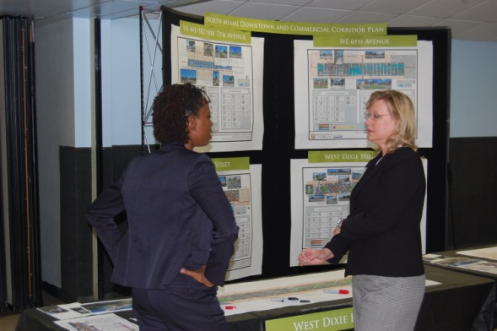
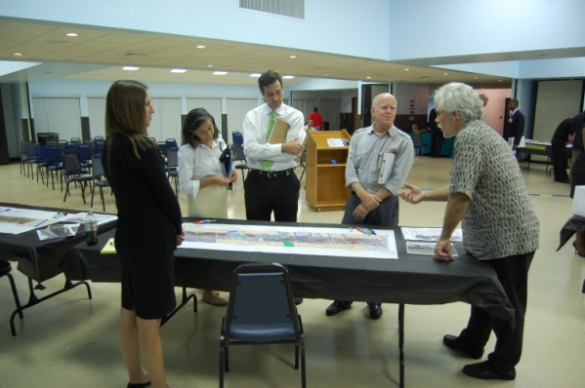
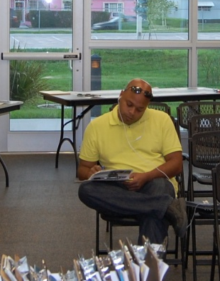
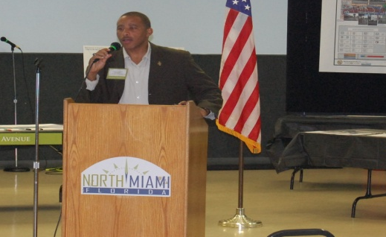
Downtown Development Plan
Process: (cont’d)
Two Business Community Workshops in 2012

Slide 7
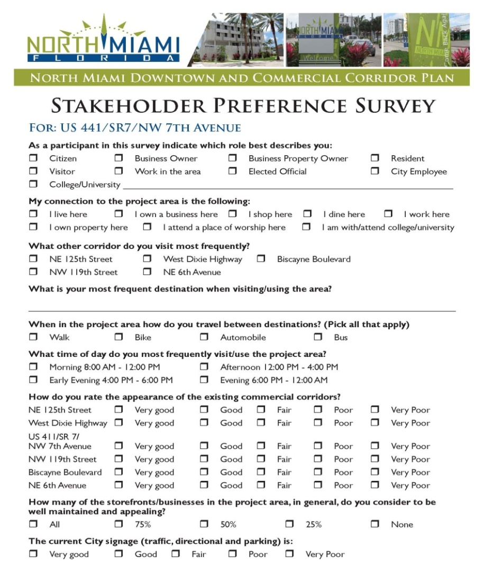
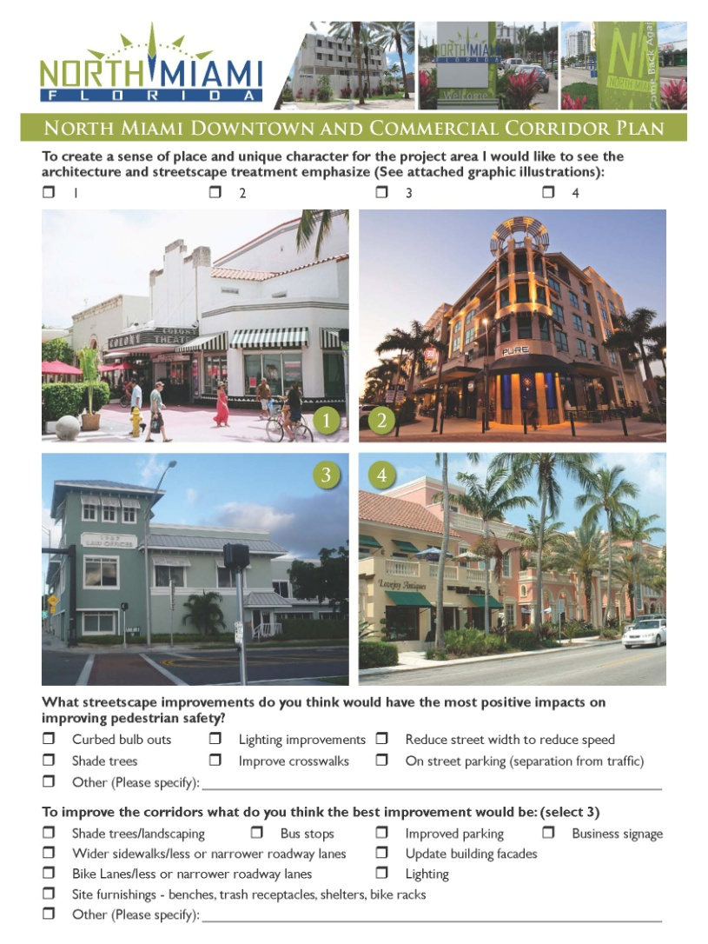
Downtown Development Plan
Process: (cont’d)
Stakeholder Preference Surveys

Slide 8
Downtown Development Plan
Business Forum Comments – what did we hear common for all corridors related to physical form?
More shade trees/landscaping/curbed medians
Make it more pedestrian friendly
Improve the pedestrian crossings
Decorative street lighting
Needs streetscape
More public plaza/areas
Slower traffic/traffic calming
Downtown area:
Unique character, sense of place, mixed-use

Slide 9
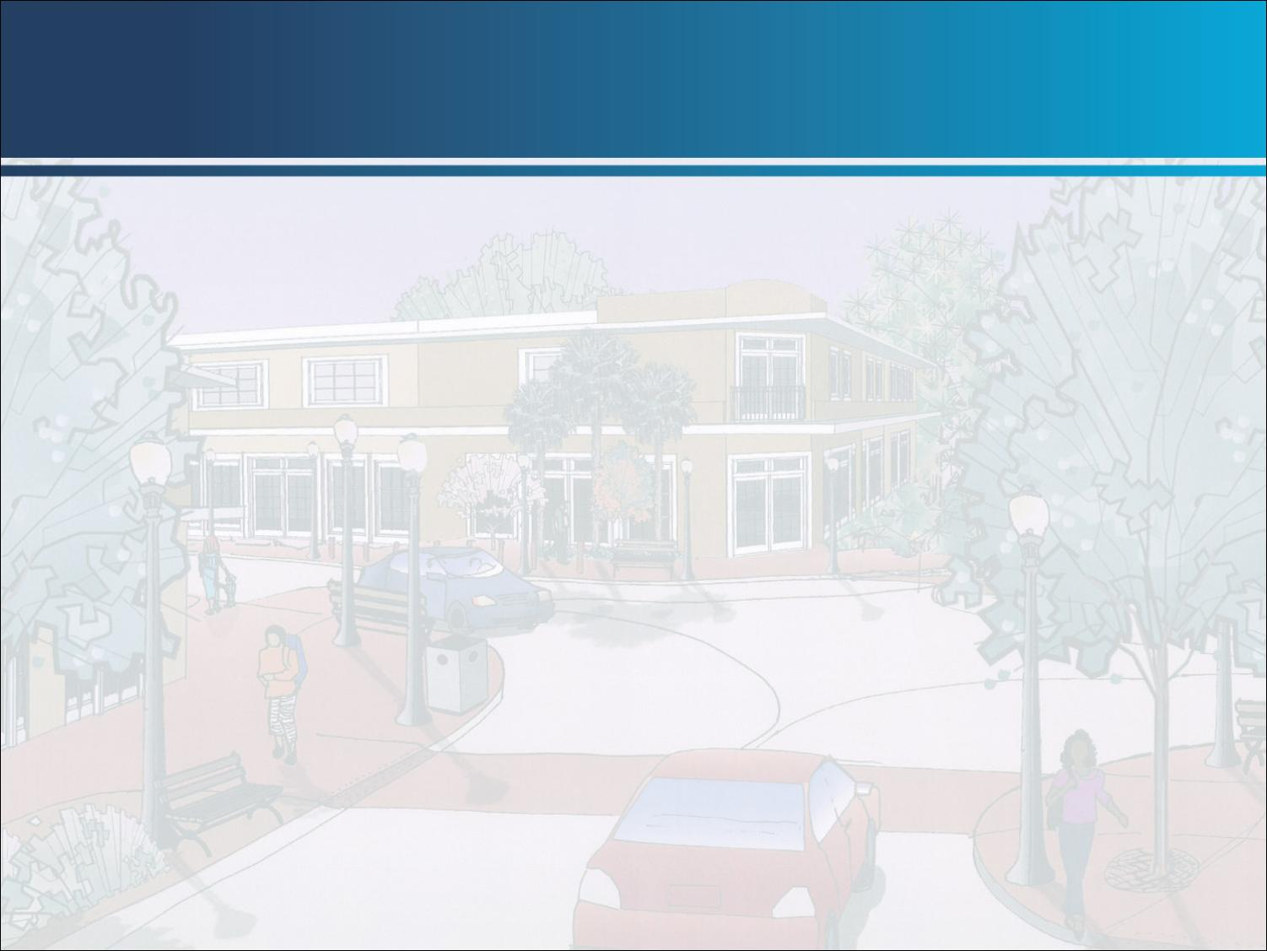
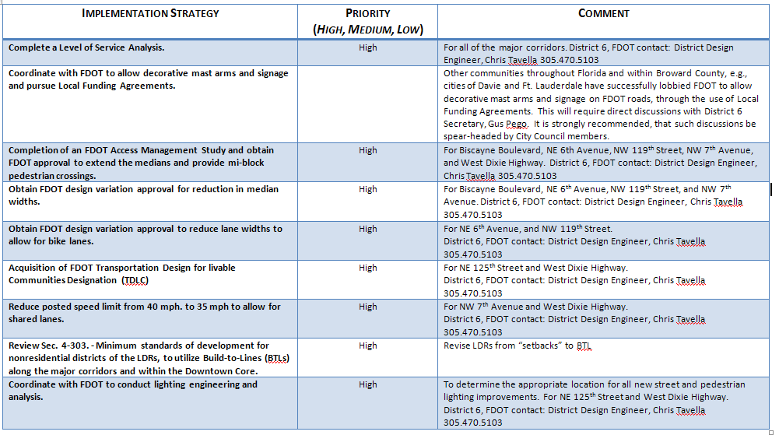
Downtown Development Plan
Implementation Strategy Recommendations
9
Notes:
9

Slide 10

Downtown Redevelopment
Patient and Long-term approach to redevelopment;
Has vision, a development plan and implementation strategies
Capitalizing upon opportunities, needs and fiscal resources;
Linking priorities of the Action Plan to the Capital Improvement Plan;
Mixed use: Bringing the residential downtown;
Ambassadors to champion the plan and keep the momentum;
Political will and community support;
Built-in flexibility to deal with expected/unexpected changes;
Regular updates to reflect changing conditions; and
Acknowledgment of the existing economic conditions of the region.

Slide 11
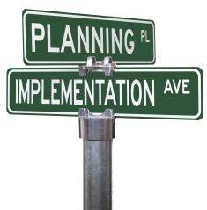
Implementation: The Action Plan
Outlines and prioritizes the next steps needed to implement the recommendations within the Master Plan.

Slide 12


Task 1: Project Start-Up Meeting
Task 3: Creation of the DAPAC
Task 4: Two Community Planning Meetings
Task 5: Order of Magnitude Opinion of Costs
Task 6: Drafting and Finalization of the Action Plan
Task 2: Presentation with City Council
Complete
Complete
Complete

Slide 13


Implementation: Community Forums
Downtown Revitalization Forum #1: April 17, 2014
What Did We Hear?
What Are The Priorities?
13
Notes:
13

Slide 14
Implementation: Community Forums
Conceptual Plan for Downtown
Expand boundaries of downtown (6th to 12th Avenue and 123rd to 126th)
Make city more walkable by offering incentives to build vertically [2 votes]
Establish a design review board once brand is established [4 votes]
Add bicycle paths/Identify easements for bicycle paths [1 vote]
Make 125th two-lanes [1 vote]
14
Notes:
14

Slide 15
Implementation: Community Forums
Conceptual Plan for Downtown
Add shade trees for walking [2 votes]
Add public gathering spaces with efficient lighting [4 votes]
Improve back alleys [1 vote]
Create pocket parks for kids in walking distance in downtown
Add street furniture, poles, public places [2 votes]
15
Notes:
15

Slide 16
Implementation: Community Forums
Traffic and Parking
Add parking garages [6 votes]
Add left/right turn lanes [1 vote]
Add traffic signs
Identify downtown bypass for thru-traffic [2 votes]
Address traffic at the Five-Points intersection (Dixie/125th Street)
Use a trolley to incorporate FEC station development to downtown [4 votes}
16
Notes:
16

Slide 17
Implementation: Community Forums
Traffic and Parking
Coordinate with upcoming I-95 Master Plan
Separate bicycle paths; not shared by cars [3 votes]
The Comprehensive Plan (city’s blueprint) should capture architectural and streetscapes and require future development to utilize transit [1 vote]
17
Notes:
17

Slide 18
Implementation: Community Forums
Creating Economic Opportunities and Incentives
Provide economic incentives for new businesses [2 votes]
Capitalize on existing antique and art retail [4 votes]
Eliminate Industrial zoning [2 votes]
Partnering with Universities and Nonprofits
Open restaurants as incubators in partnership with universities [3 votes]
Assist homeowner and businesses with a façade/paint program [2 votes]
18
Notes:
18

Slide 19
Implementation: Community Forums
Attracting Visitors, New Residents, and Businesses
Create monthly social mixers
Advertise local and social events [3 votes]
Increase the number of after 5 PM activities [2 votes]
Add apartments and residential downtown [2 votes]
Create a brand for North Miami/Use NoMi, which is “Know Us”, as the city’s brand [2 votes]
Close downtown street(s) three or four times per year for fairs. This should be advertised.
19
Notes:
19

Slide 20
Implementation: Community Forums
Attracting Visitors, New Residents, and Businesses
Enlarge Central Business District to support Port of Miami and Port of Everglades related businesses [3 votes]
Partner with Biscayne Park on monthly events [1 vote]
Increase police presence
Add a civic center for tradeshows, musicals, business attraction
20
Notes:
20

Slide 21
Implementation: Community Forums
Attracting Visitors, New Residents, and Businesses
Increase advertising at airports and seaports
Hire a public relations firm once the city’s brand has been set
Make downtown family- and pet-oriented [1 vote]
The most popular strategy is…
Create gateways and a central focus such as a megablock at MOCA/City Hall [10 votes]
21
Notes:
21

Slide 22
Implementation: Funding Opportunities
Traditional Funding Sources
General Fund
General Revenues: property tax revenues, sales tax revenues.
Parking Revenues: City owned parking lots and on-street parking along the Avenue should become a possible source of revenue.
Local Gas Tax: The City's share of gas tax revenues
22
Notes:
22

Slide 23
Implementation: Funding Opportunities
Traditional Funding Sources (cont’d)
Bond Financing: General Obligation (GO) bonds that require a referendum, and Revenue Bonds pledging identified sources of revenues other than property taxes.
23
Notes:
23

Slide 24
Implementation: Funding Opportunities
Newer Funding
Special Taxing Districts:
Tax Increment Financing (TIF): Infrastructure and improvements funded through the use of increases in the tax base resulting from the improvements.
Business Improvement District (BID): fund Infrastructure, improvements, maintenance, and publicity funded through additional ad valorem taxes.
Benefit District: similar to BID without forming organizational structure
24
Notes:
24

Slide 25
Implementation: Funding Opportunities
Newer Funding
Streetscape Utility Fees
Streetscape Utility Fees: could help support streetscape maintenance of the area between the curb and the property line through a flat monthly fee per residential dwelling unit.
Non-residential customers would be charged a per foot fee based on the length of frontage on streetscape improvements. This amount could be capped for non-residential customers with extremely large amounts of street frontage. The revenues raised from Streetscape Utility fees would be limited by ordinance to maintenance (or construction and maintenance) activities in support of the streetscape.
Stormwater Utility Tax Financing
25
Notes:
25

Slide 26
Implementation: Funding Opportunities
Federal Grants
Community Development Block Grant
Preserve America Initiative Grant
Grow America Act (just submitted to Congress)
National Scenic Byways Grant
Transportation Alternatives Program (TAP) Grant
FHWA Discretionary Grant Programs
Green Infrastructure Funding and Grants
Intermodal Funding and Grants
26
Notes:
26

Slide 27
Implementation: Funding Opportunities
State of Florida Funding
FDOT Direct Funding
Florida Highway Beautification Council Grant Program
Florida DOT “Safe Routes to School funds”
State Infrastructure Bank (SIB) Program
27
Notes:
27

Slide 28
Implementation: Funding Opportunities
Miami-Dade County
Metropolitan Planning Organization (MPO)
Funds for all types of Transportation Construction and Planning within County, also
Miami Metropolitan Planning Organization Municipal Grant Program
28
Notes:
28

Slide 29
Implementation: Funding Opportunities
Sponsorships
Fundraising and sponsorship opportunities provide for a generous way to collect funds to be earmarked for special projects in the district. Residents and/or businesses can purchase personalized paver bricks used in public patios, park bench plaques, trees with memorial plaques, public art, etc. The collected funds can be used to generate income for patio installations, tree plantings, bench purchases, etc.
29
Notes:
29

Slide 30
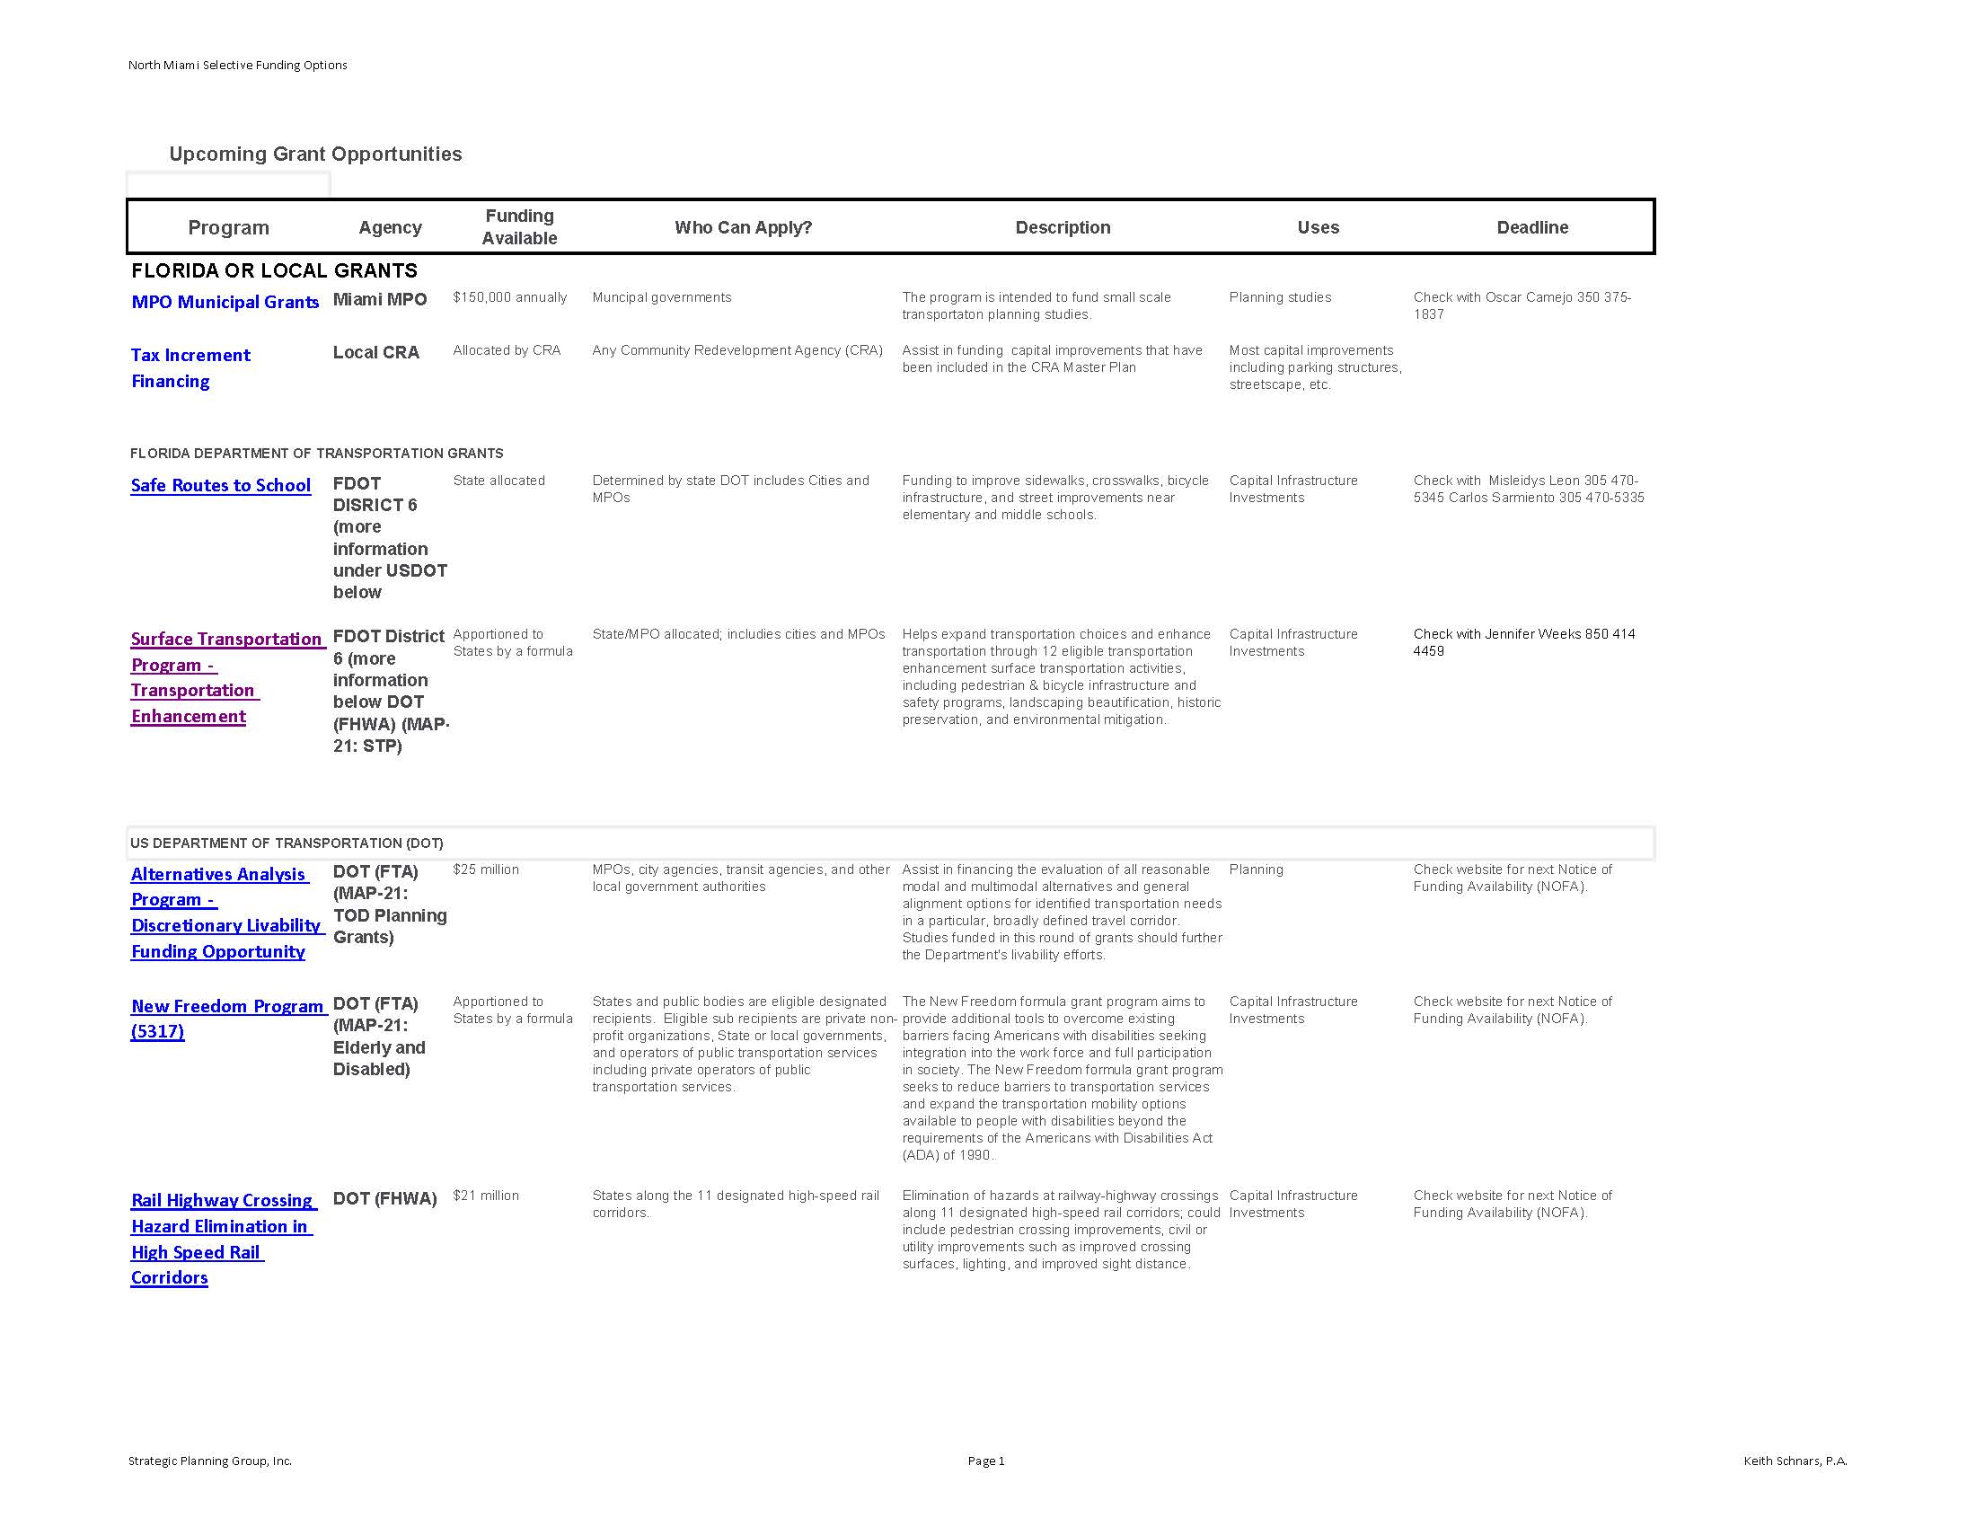
Implementation: Funding Opportunities
30
Notes:
30

Slide 31
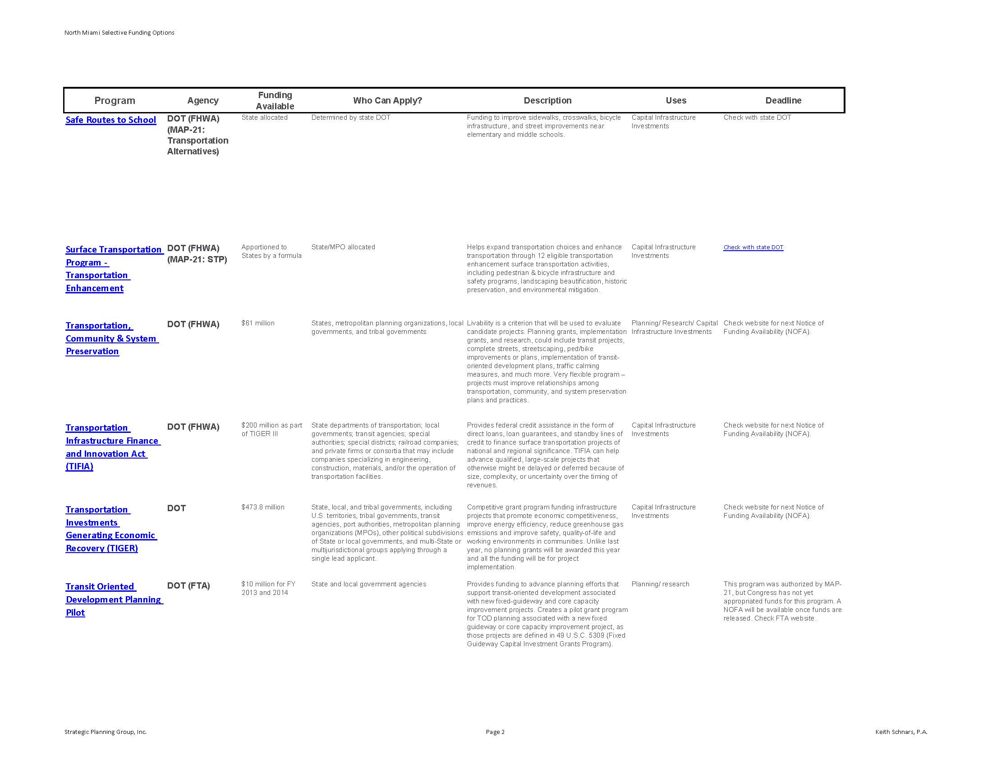
Implementation: Funding Opportunities
31
Notes:
31

Slide 32
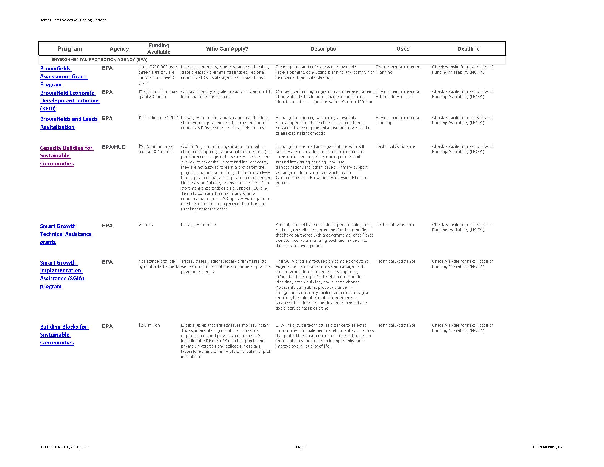
Implementation: Funding Opportunities
32
Notes:
32

Slide 33
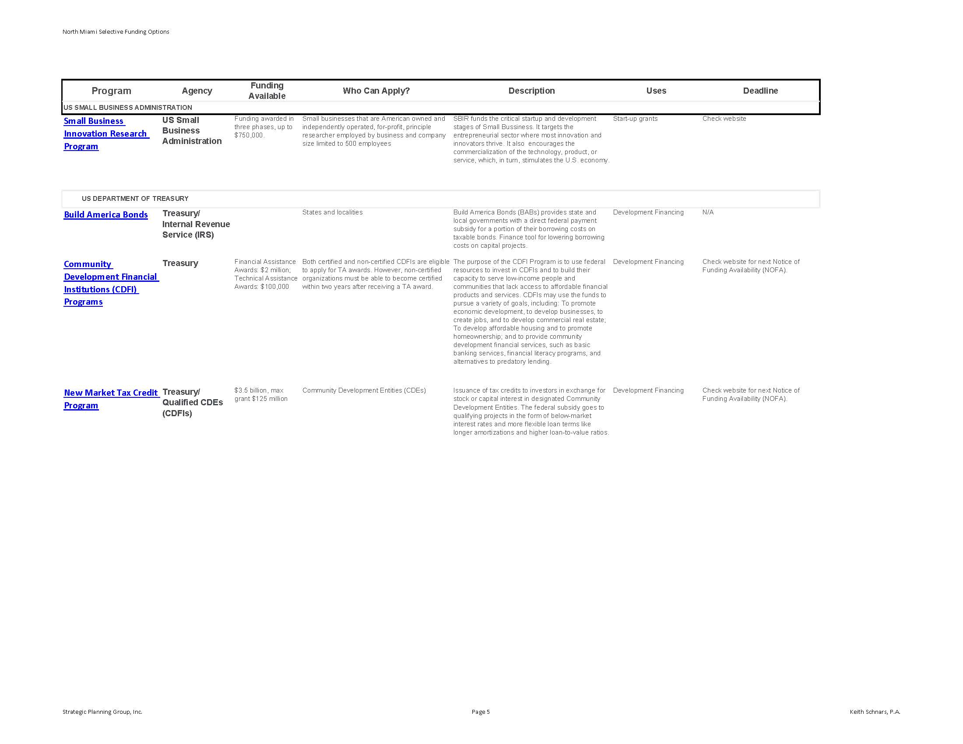
Implementation: Funding Opportunities
33
Notes:
33

Slide 34

Thank You for Joining Us!
34
Notes:
34

